Slide 1


Predictive Modelling of COVID-19 Vaccination Adverse Events
- Team Side Effects -

Slide 2
Goals & Aims
Find the significant predictive factors for SARS-CoV-2 Vaccine Adverse Events

Slide 3
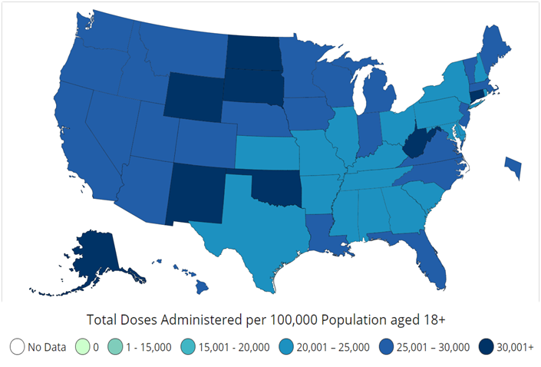
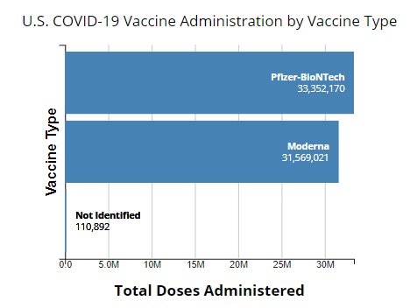
Current State Of Vaccination In The U.S.

Slide 4


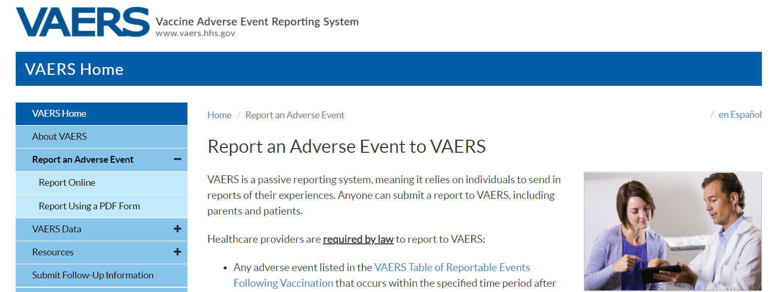
Our Main Resources

Slide 5
Significance
A better understanding of vaccination side effects will better prepare healthcare professionals for more vulnerable individuals
Understanding which features will encourage people to take vaccines and to dispel rumors or misinformation

Slide 6
Challenges
No available literature on SARS-CoV-2 vaccination adverse effects
Data requires extensive cleanup due to inconsistent terminology
Discrepancies in adverse event initial reporting

Slide 7
Novelty
No current study has focused upon the adverse effects of SARS-CoV-2 vaccinations or their predictive factors
Categorical Symptoms and their Severity
No knowledge on the contributive factors (i.e. demographic metadata) to vaccination side effects across different vaccine types

Slide 8
Workflow
Vaccine/Symptom Data
Pre-processing/ Cleaning
Web Portal
Prediction
Predictive Model
Visualization

Slide 9
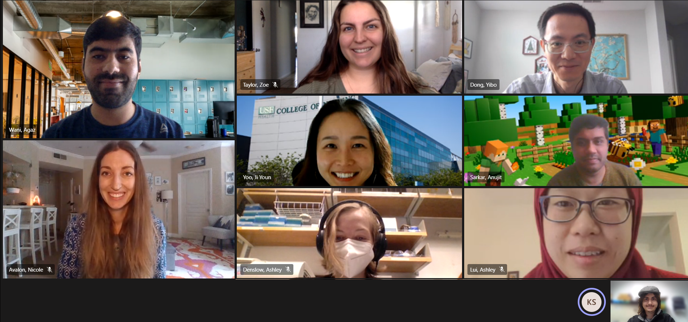
Team Side Effects

Slide 10


Team Credits
Anujit Sarkar (Team Lead)
Agaz Wani (Team Lead)
Nicole Avalon
Ashley Denslow
Yibo Dong
Ashley Lui
Peter Radulovic
Krishna Sharma
Zoe Taylor
Ji Youn Yoo

Slide 11
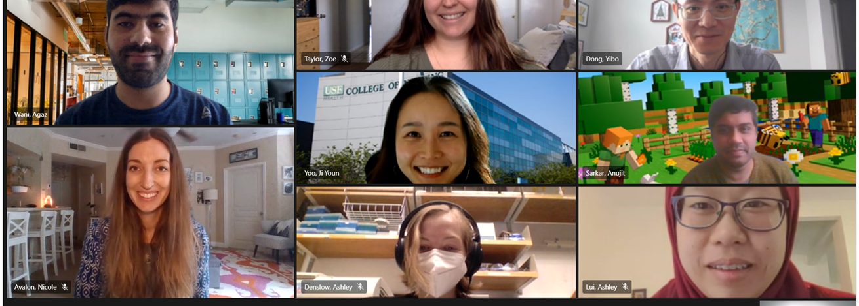
Predictive Modelling of COVID-19 Vaccination Adverse Events
- Team Side Effects -

